Slide 1
Business Continuity and Resiliency in Azure

Slide 2
Business Continuity and Resiliency
Represent the ability to perform essential business functions during and after the adverse condition such as natural disaster or failure of a service.
Ensure that your internal and external applications, workloads and services are resilient and remain operational during planned downtime and unplanned outages
Architecting for resiliency focuses on failure recovery, rather than on avoiding the failure.

Slide 3
High Availability and Disaster Recovery
High Availability – Ability of the application to continue running in a healthy state despite localized or transient failures.
Disaster Recovery – recover from major incidents. Data backup and archiving
Ex: Order processing application

Slide 4
Virtual Machine High Availability
Availability Sets – Single Point of Failure
Availability Zones – Datacenter level failure
Virtual Machine Scale Set - Autoscaling
Replication of VM
Multi-Region

Slide 5
Data Backup
Backup is distinct from data replication
Ex: Azure Storage replication:
LRS
ZRS
GRS
RA-GRS
GZRS
RA-GZRS

Slide 6
Identifying Requirements
Recovery Time Objective (RTO) – Maximum acceptable time that an application can be unavailable after an incident Ex: RTO is 90 min
Recovery Point Objective (RPO) – Maximum duration of the data loss that is acceptable during a disaster.
Mean Time To Recover (MTTR) – It is average time that it takes to restore the application after a failure

Slide 7
Service Level Agreement
Uptime and connectivity
Obtain service credits if SLA’s are not met

Slide 8
Estimating SLA Downtime
Ex: Web App writes the data to Azure SQL Database
App Service = 99.95%
SQL Database = 99.99%
Composite SLA = 99.95% x 99.99% = 99.94%
SQL database is unavailable, Add queue – transactions get stored in the queue
Service Bus Queue = 99.9%
Web App AND (Database or Queue) ~ 99.95%

Slide 9
Application Design: Failure Mode Analysis
FMA is a process for building resiliency into an application early in the design stage.
Identify what types of failures an application might experience
Capture the potential effects and impact of each type of failure on the application
Identify recovery strategies

Slide 10
Ecommerce Application
Traffic Overload
Login Issues
Database Failed
Payment Outage
Application Unavailability
Network Outage
Certificate Errors
Inventory
Hacked
Data Security – Man In The Middle, DDOS

Slide 11
Ecommerce Application
Application not reachable – 4xx, 5xx – HA, scalability
Slow response from some pages – throttling – 429 – too many request – scalable, DDOS
Authentication – HTTP 401 (unauthorized), HTTPS, SSL Certificates
Website not being browser compatible – Application Design, Responsive
Component Failure – Individually FMA for component
Integration Service – DB, Messaging, LB

Slide 12
Avoiding a Single Point of Failure
Single VM – with a Premium Disk – 99.95%
Availability Sets – 99.95%
Availability Zones – 99.99%
Azure Site Recovery – Replicate azure virtual machines to another Azure regions
Paired Region

Slide 13
























Autoscaling and Load Balancing
App Services – Standard tier onwards
Load Balancers – 2 VMs minimum
Traffic Manager – Traffic Routing
VMSS

Slide 14
Traffic Manager
DNS request and response
Allows us to control the distribution of user traffic to your service endpoints running in different datacenters around the world
Techtrics.trafficmanager.net

Slide 15
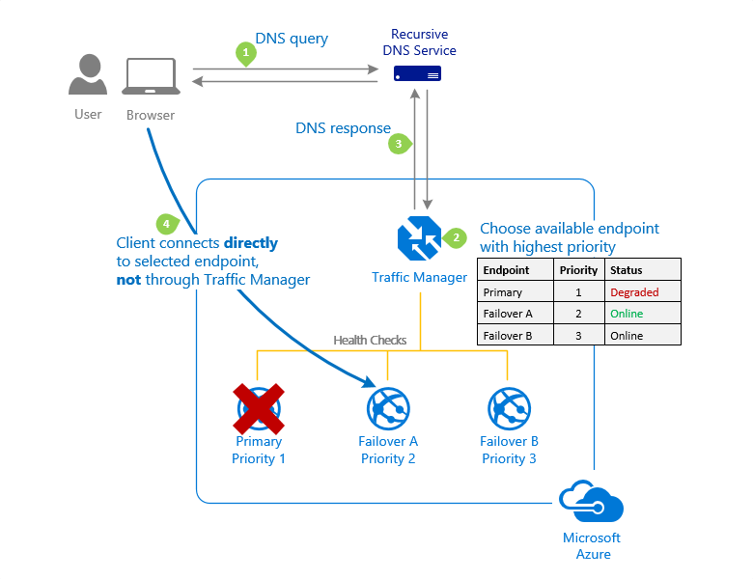












Slide 16
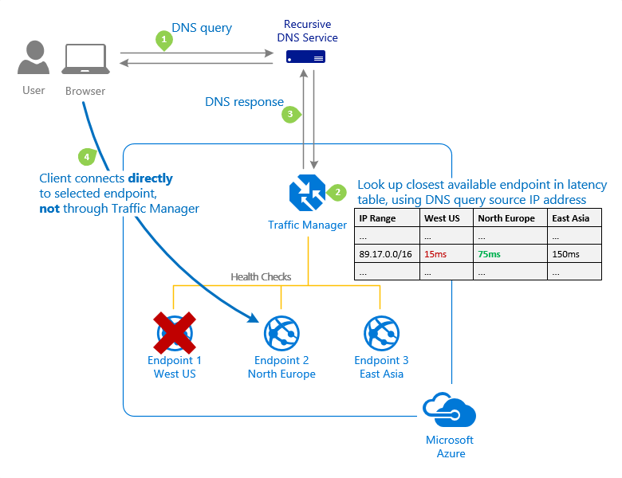

Slide 17
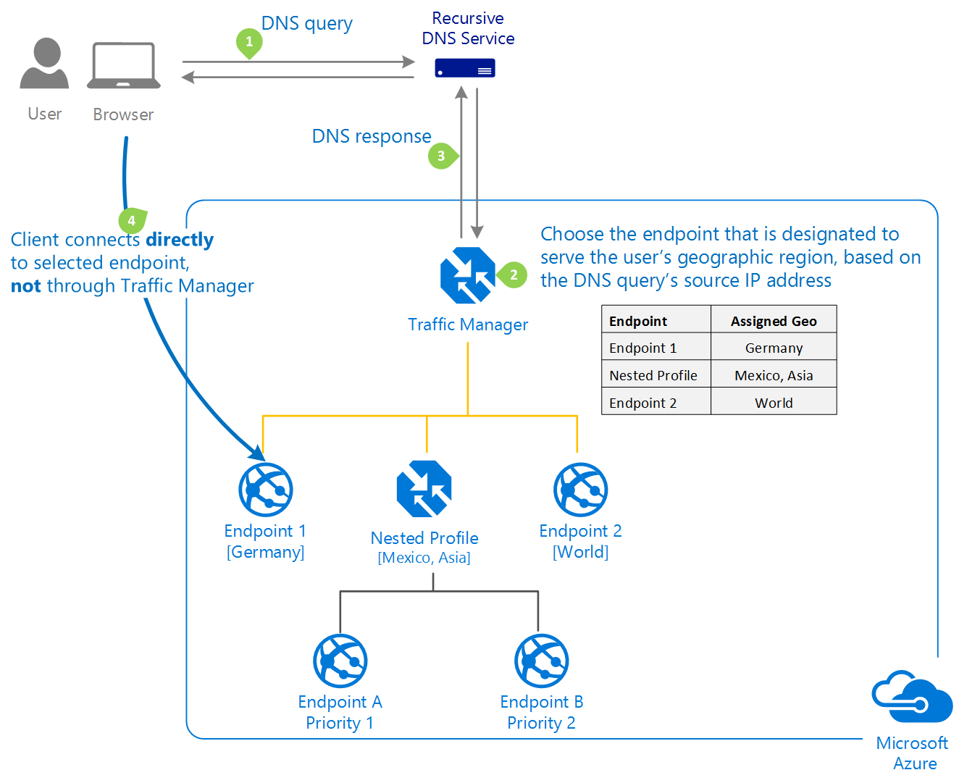

Slide 18
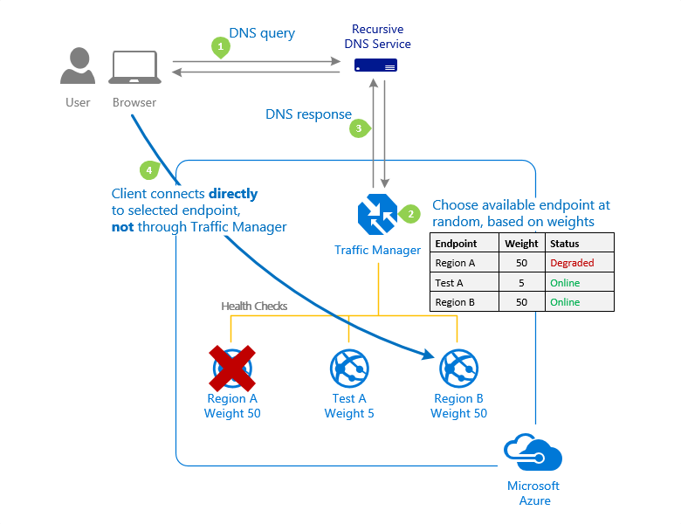


Slide 19
Workload Service Level Objectives
If a service is composed of critical and less-critical workloads, manage them differently and specify the service features

Slide 20
E-Commerce Application
Product | Availability | Scalability | Data Consistency | Disaster Recovery
Order Management | Y | Y | Y | Y
Payment | Y |  | Y | Y
Login | Y |  | Y
Inventory Management |  |  | Y
Cart and Checkout | Y | Y | Y | Y
Search | Y | Y |  | Y
Catalog | Y |  | Y
Order Management – Critical
Payment - Critical
Login - Critical
Inventory Management – Non-critical
Cart and Checkout - Critical
Search - Critical
Catalog – Non-critical
Shipping - Critical
Customer Support – Chat/Email/Call – Non-critical
Seller Management - Critical

Slide 21
Video Streaming Application (Netflix, Hot Star, Amazon Prime)
Product | Categorization
Login | Critical
Search | Critical
Streaming Engine – Highest Traffic | Critical
Storage | Critical
Uploads | Non-Critical
Queuing | Critical
Payment | Critical
User Profiles | Non-Critical
User Experience | Non-Critical
Catalog | Critical

Slide 22
Best Practices
Minimize and understand the service dependencies
Scalability
Availability
DR
Data Consistency
Requirements being based on your business relevance
Security

Slide 23



Enhancing Security
DDoS – Network Layer
DDoS – Application Layer – Captcha, Image Recognition
SSL Certificate – HTTPS
Principal of least privilege – RBAC
MFA – Authorization and Authentication
NSG – Subnet and NIC
Subscription
RG1
Resource1
Resource2
RG2
Resource3

Slide 24










Slide 25
Hacking
Phishing – Ensure you watch URL properly – Fake mail – facebook.xyz.com
Key Logging
Simple Passwords – Mobile Number, Yourname@birthyear, Yourspousename@birthyear – Brute Force Attack
Security Questions – Right answers to the security question
Ethical Hacking – Learning
Trojan and Malwares
Cross Site Scripting

Slide 26
Resiliency Tips
Design applications to gracefully degrade - scalability
Throttle high-volume users
Use load leveling to smooth spikes in the traffic
Monitor third party services

Slide 27
Testing, Deployment and Maintenance
Automate and test deployment and maintenance tasks
Azure resource provisioning – ARM Templates, Azure CLI, Azure Powershell
Deploying application code – DevOps, automated deployment process
Applying configuration settings – Desired State Configuration (DSC), Custom Script Extension

Slide 28





Custom Script Extension
Virtual Machine
Storage Account
Script File

Slide 29
Infrastructure as a Code – ARM Templates
Agile development methods
Repeatedly deploy a solution – reliable state
ARM template is a Java Script Object Notation (JSON) file that defines infrastructure and configuration for your project

Slide 30
Why Choose ARM Templates
Declarative syntax
Repeatable results
Orchestration
Create any Azure resource
Testing
Built-in validation
Exportable Code

Slide 31
Template File
$schema - required
contentVersion – required
Parameters
Variables
User-defined functions
Resources - required
Outputs

Slide 32




Slide 33
Maximize Application Availability
Blue-green deployment – Achieve with App Service Slots
Canary release – Release to small set of users and eventual roll out of 100% of the traffic

